Slide 1


Project name: OpenROAD VLSI Design II Team members:Githin, Giovani,
Kevin, Talha

Slide 2
Project description
Problem statement: “Traditional RTL-to-GDSII chip design involves many complex, manual stages that are dependent on human expertise.”
Logic Synthesis
Placement
Clock Tree Synthesis
RTL Design
Routing
GDSII/Tapeout

Slide 3
Project description
Proposed Solution: “OpenROAD will expedite this lengthy design process, requiring only an RTL description while the toolchain automatically performs essential tasks to produce a fabrication-ready layout.”
Logic Synthesis
Placement
Clock Tree Synthesis
RTL Design
Routing
GDSII/Tapeout
OpenROAD/OpenLane

Slide 4
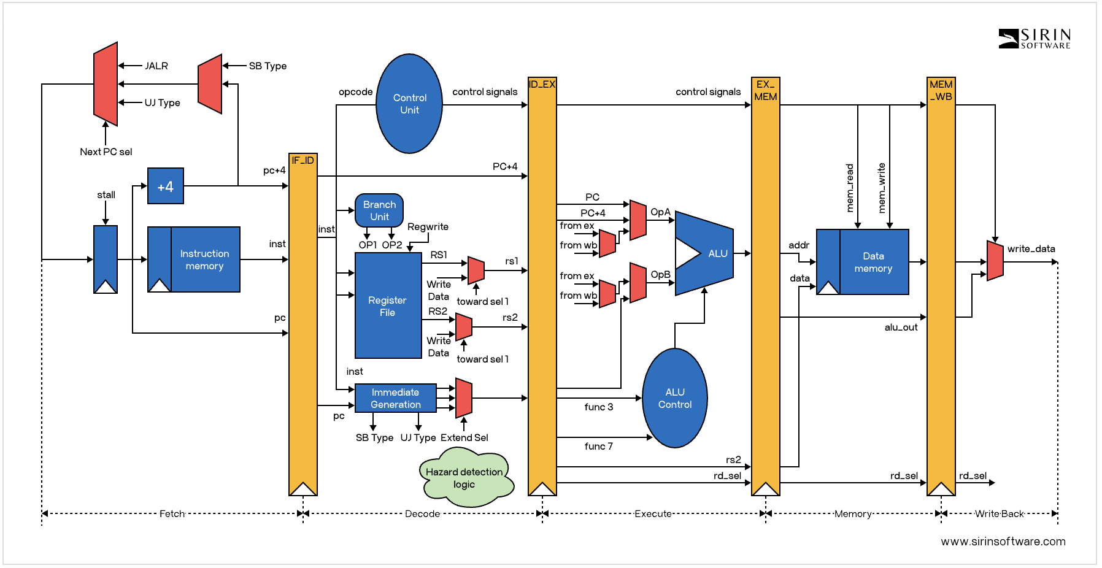



System Overview
Kevin
Githin
Talha
Giovani
Notes:
https://sirinsoftware.com/blog/inside-risc-v-microarchitecture

Slide 6
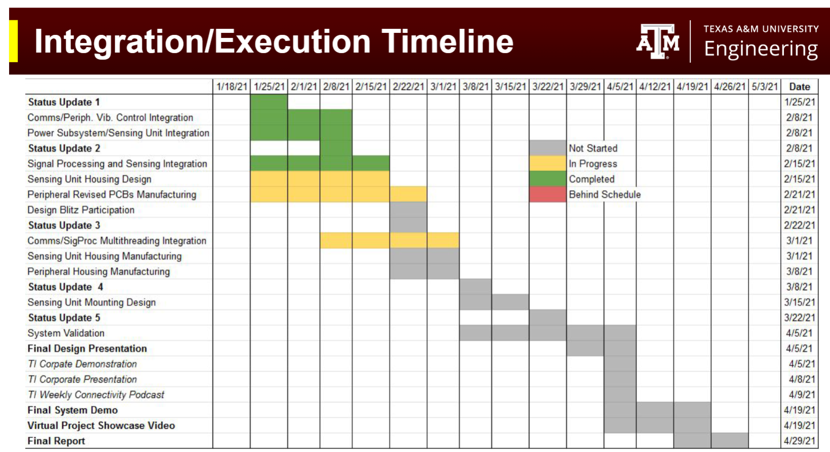
Execution plan
Updated to show progress or slip…highlight differences

Slide 7
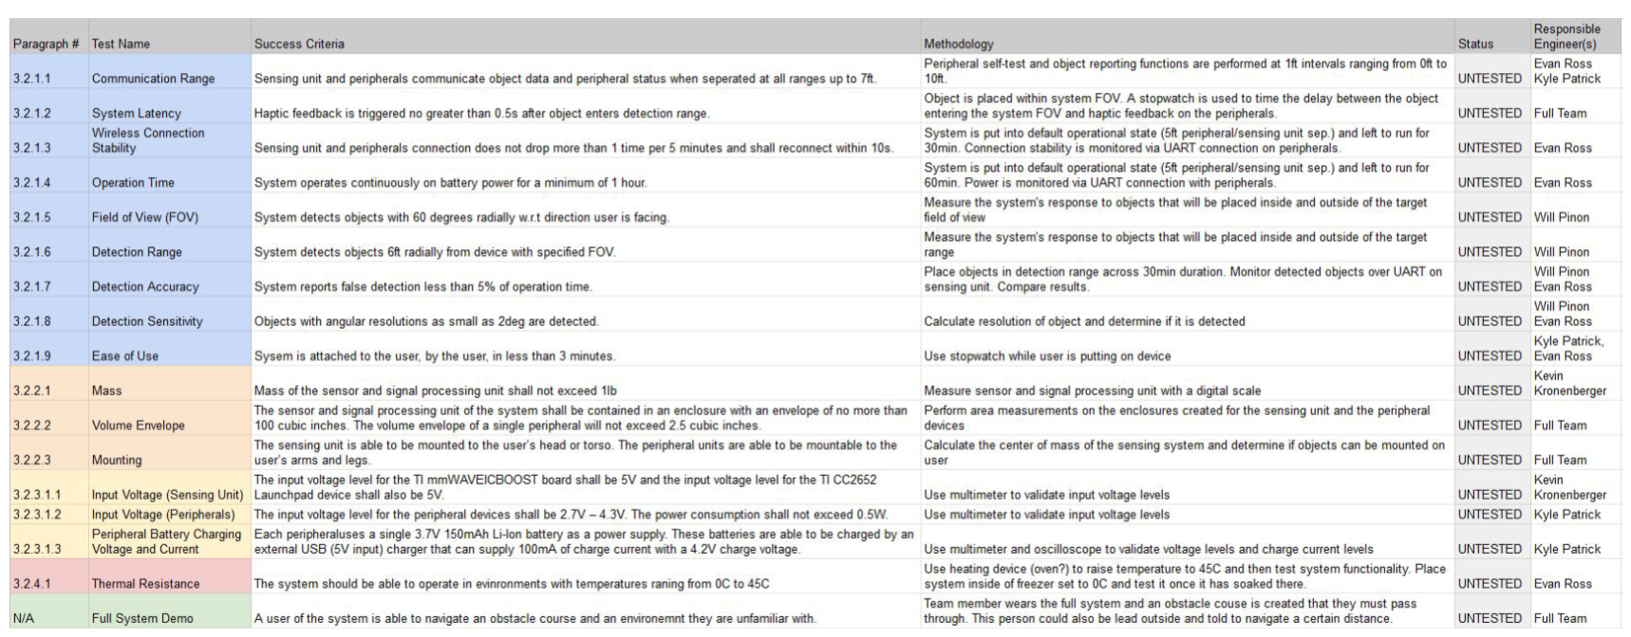
Validation plan
Update Validation Plan….what has been tested?

